Slide 1
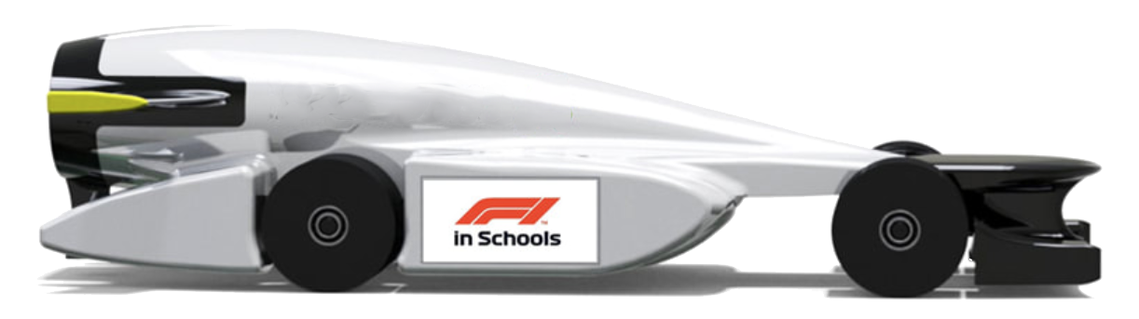

What is Acceleration?
Distance
0 metres
1 metres
2 metres
3 metres
4 metres
5 metres
0 secs
Stationary
1 secs
2 secs
Speed = distance / time
3 secs
Speeds between points?
1m/s
2m/s
2m/s
Acceleration = change in speed / time
Accelerations?
1m/s/s
1m/s/s
0m/s/s

Slide 2
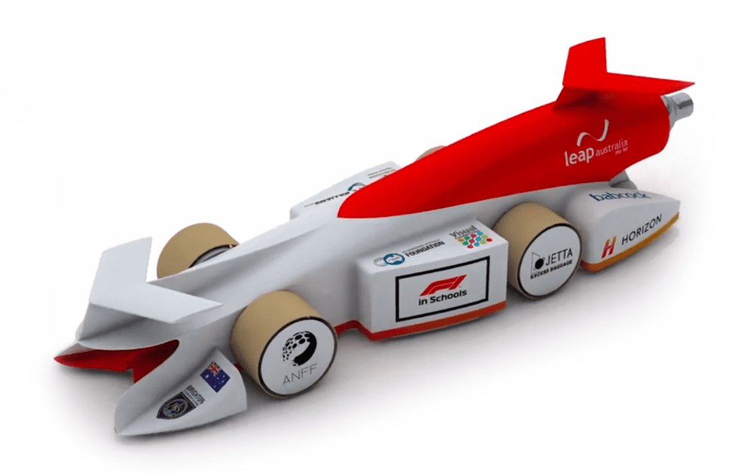
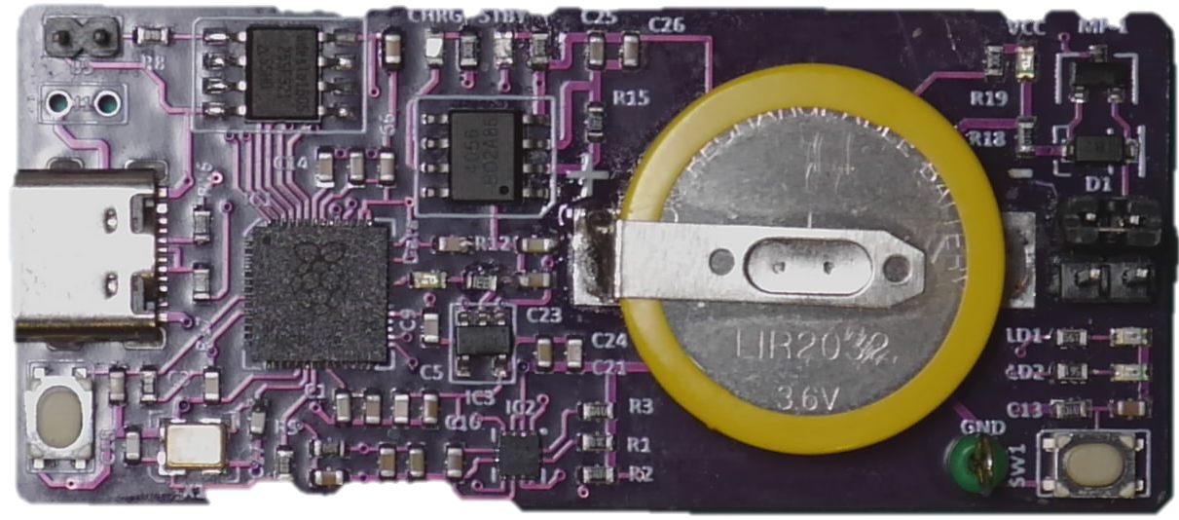
Measuring Accelerations
Z
Accelerations are measured in 3 axes
Which acceleration(s) are desirable?
Which accelerations are not desirable?
What is special about the Z axis?
X
Y

Slide 3
Forces
Newton’s Laws of Motion:
An object will not change its motion unless a force acts on it.
The force on an object is equal to its mass times its acceleration. (F=ma)
When two objects interact, they apply forces to each other of equal magnitude and opposite direction.
Consider:
What forces act on the car?
What are the effects of the forces?
Which forces help to win races?
Why is the car’s mass important?
Why is the car’s shape important?

Slide 4
Forces Acting
Gravity
Gas
Propulsion
Uneven Track
Wheels out of round
Aerodynamic lift
Propulsion misaligned
+-Z
Z
Y
Misalignments with centre of mass
Propulsion
Wheels
Aerodynamic
+/-X
-Y
Air Drag
Wheel Friction
Z-
Earth
Opposition

Slide 5
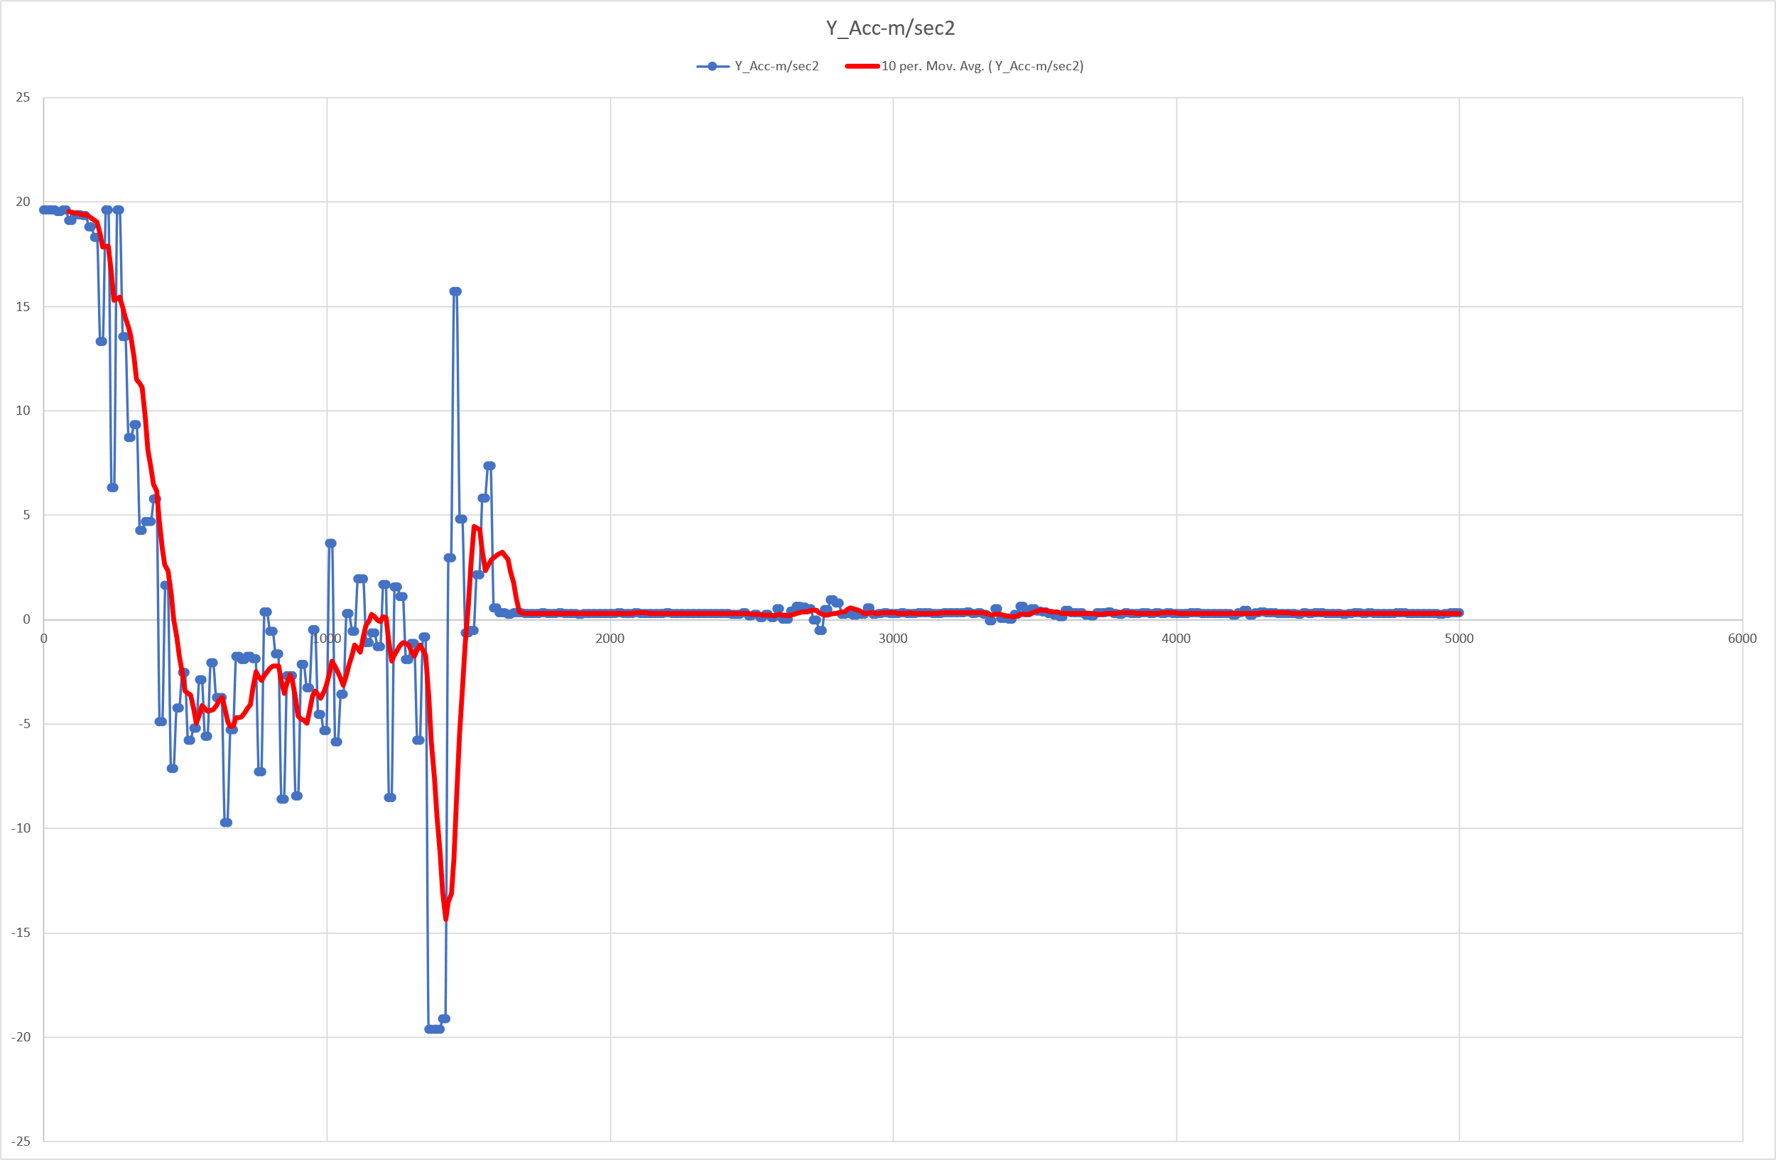
Y (Forwards) Acceleration Data
Propulsion
Stationary
Propulsion stops
Stopping
Coasting / Deccelearting

Slide 6
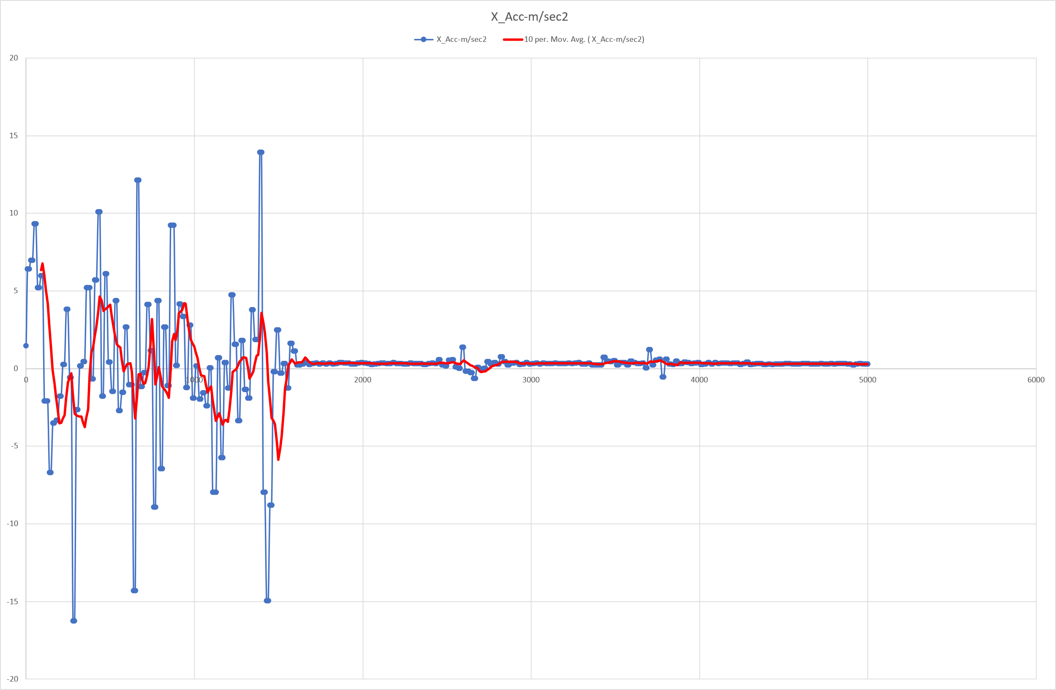
X (Sideways) Acceleration Data
Side Forces
Stationary

Slide 7
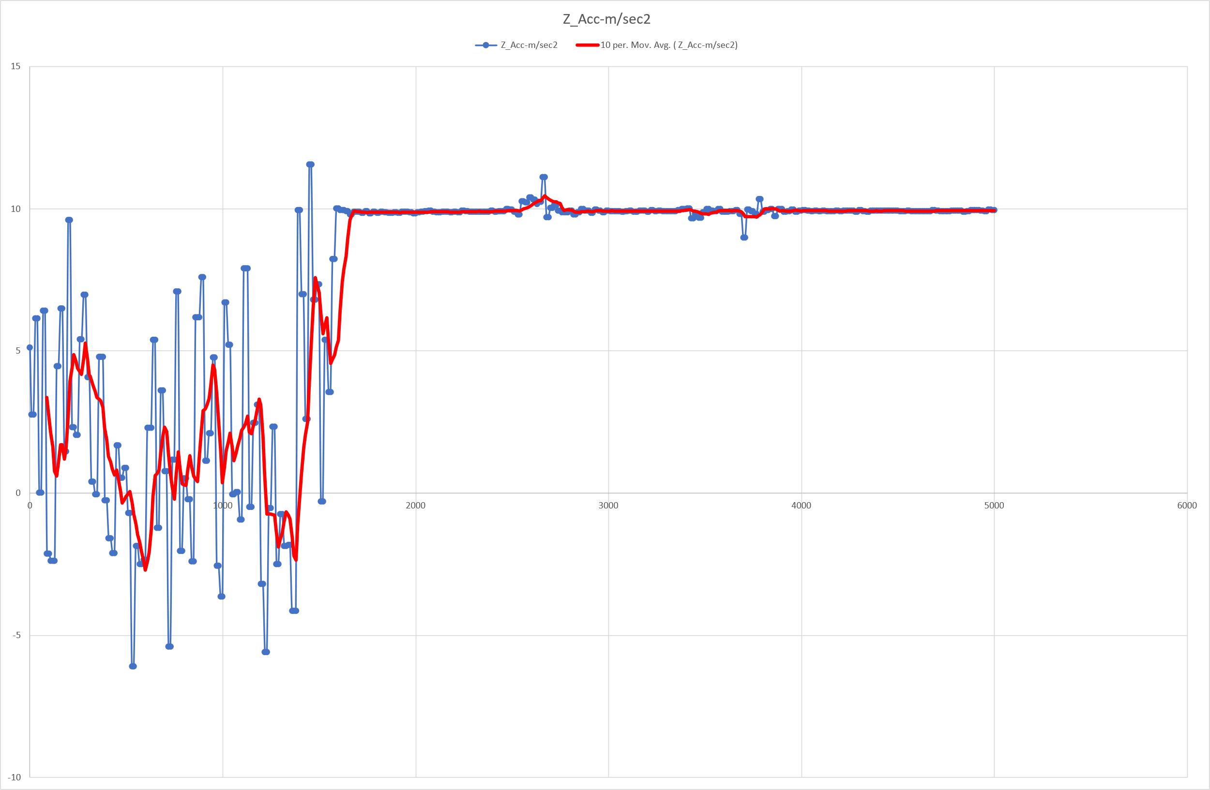
Z (Vertical) Acceleration Data
Stationary / Gravity
Lifting Forces

